Slide 1
Data-Driven Agriculture: Supporting Malawi’s Fertilizer and Soil Health Goals
Kumbukani K. Munthali

Slide 2
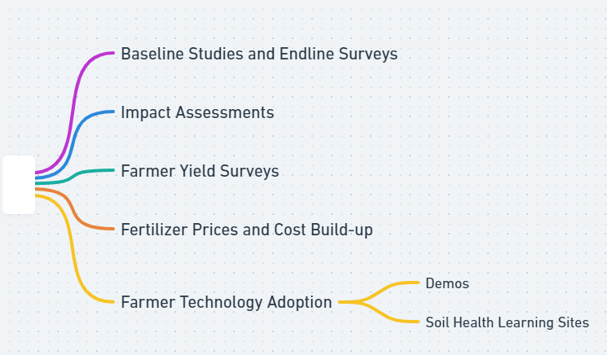
Motivation For Data Collection
Our motivation for data collection primarily centers around understanding and improving our programming and outcomes
The focus is on improving agricultural productivity and soil health for smallholder farmers. Data is collected at different stages of project interventions including:

Slide 3
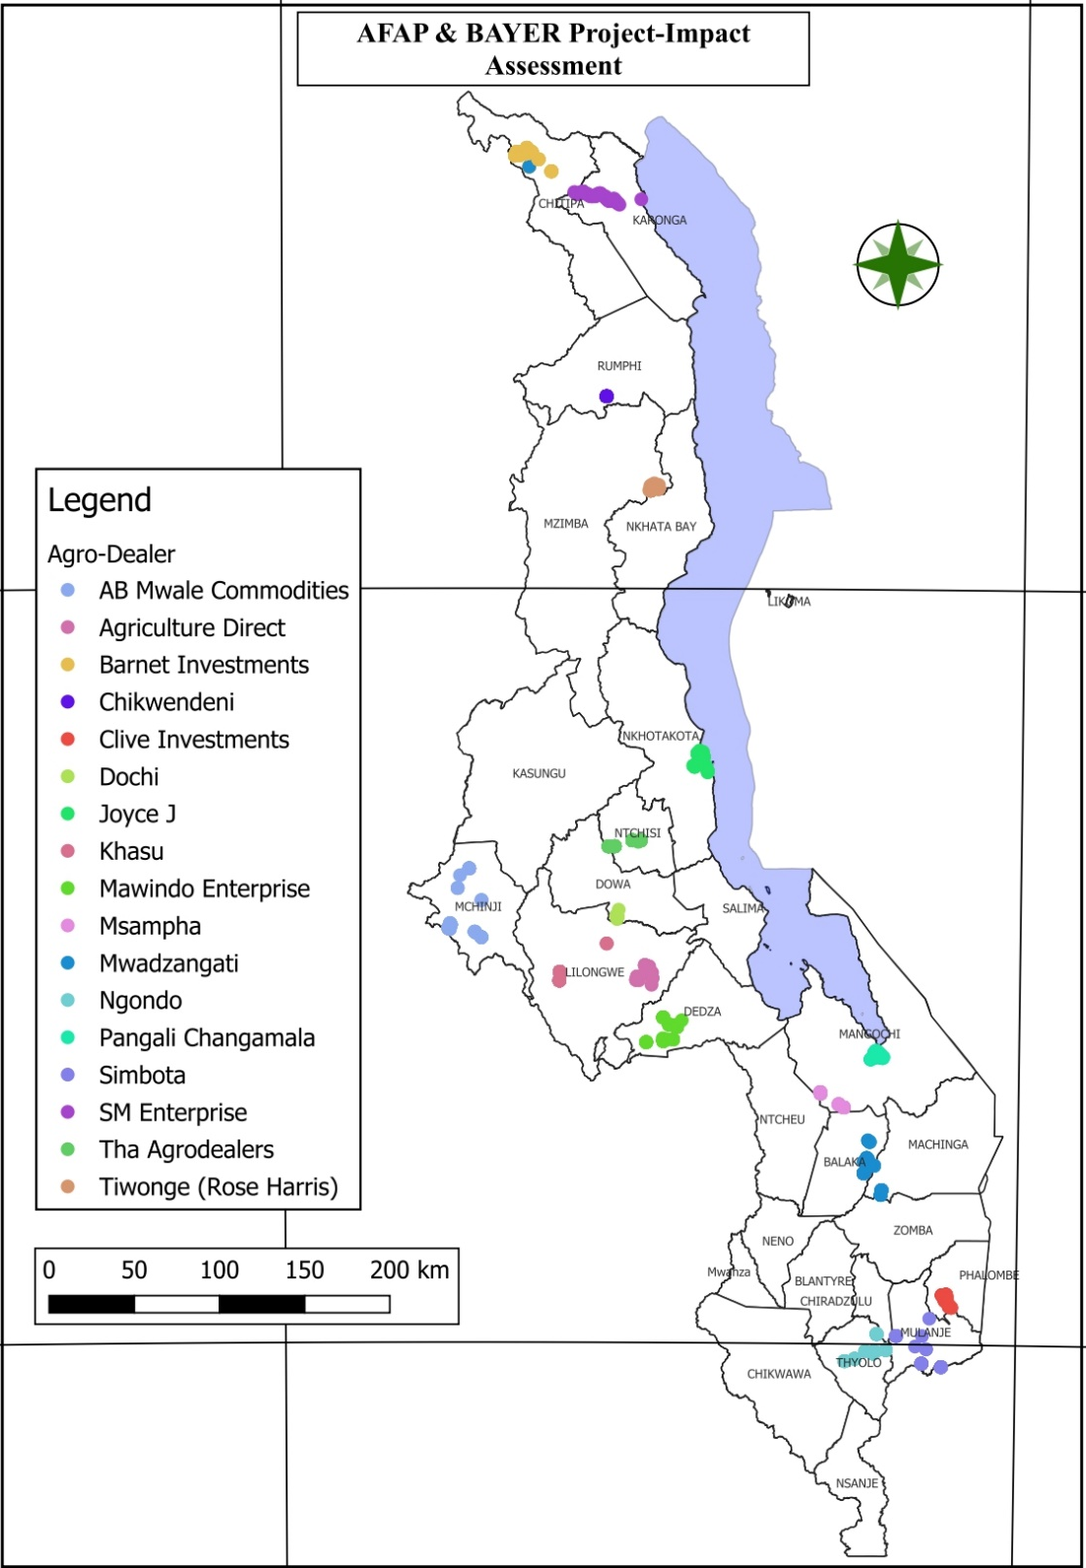
Population & Units of observation
The data represents smallholder farmers in Malawi, covering all three regions
Units of observation include;
Farmer Demographic Data,
Technology awareness and adoption
Crops Grown
Access to inputs
Yield
Fertilizer Use
Post-harvest management
Access to Extension Services
Digital Penetration
The surveys also consider livestock production and land ownership dynamics.

Slide 4
Dates of Data Collection
Studies, Surveys, Assessments, and evaluations carried out between 2015 and 2024 under various projects.
Project | Period
USAID Accelerated Innovation Delivery Initiative (AID-I) - CIMMYT | 2023 – 2025
FARMSE – Savings for Agriculture and Marketing | 2023 – 2025
Sustain Africa Malawi | 2022 – 2023
Sustainable Agriculture Production and Marketing for Rural Transformation (SAP-MaRT) | 2021 – 2023
BAYER - Better Farms Better Lives Advancing the Benefits in Malawi | Since 2020
YARA Action Africa-Thriving Farms Thriving Future | 2020 - 2022
Strengthening Fertilizer Systems Through Promotion of Area-specific Fertilizer Blending in Malawi. | 2018 - 2020
Bill and Melinda Gates Foundation (BMGF) | 2018 - 2022
Productivity Improvement Program for Smallholders (PIPS) | 2015 – 2017

Slide 5
Sampling Methods & Sample Size
In conducting surveys, studies, and impact assessments, various sampling methods were employed, at times a combination of random, purposive, and mixed sampling methods.
Random sampling: Particularly useful in farmer yield surveys and technology adoption assessments.
Purposive sampling: Strategically used to target specific groups and locations, such as key fertilizer suppliers and market segments, to gather detailed data on prices and cost build-ups.
Mixed sampling: Mostly used for Baseline and End-line surveys, as well as Soil Health Learning sites, to enhance the depth and breadth of the data collected, ensuring both representativeness and focused insights.
Sample Sizes were broad, covering at times all regions and districts, and specific figures for project-specific. The

Slide 6
Summary of Information Collected
Baseline Studies and End-line Surveys, Impact Assessments
Demographic details
Initial status of key indicators (e.g., income levels, crop yields)
At the end, similar data are recollected to assess progress and impact.
Changes in productivity or income
Soil Health Learning Sites
Soil composition and nutrient levels
Effectiveness of soil improvement techniques
Changes in soil health over time as a result of adopted practices.
Fertilizer Prices and Cost Build-up
Current market prices of different fertilizers,
Factors influencing price fluctuations, Cost components involved in manufacturing and distribution
Economic accessibility for local farmers.

Slide 7
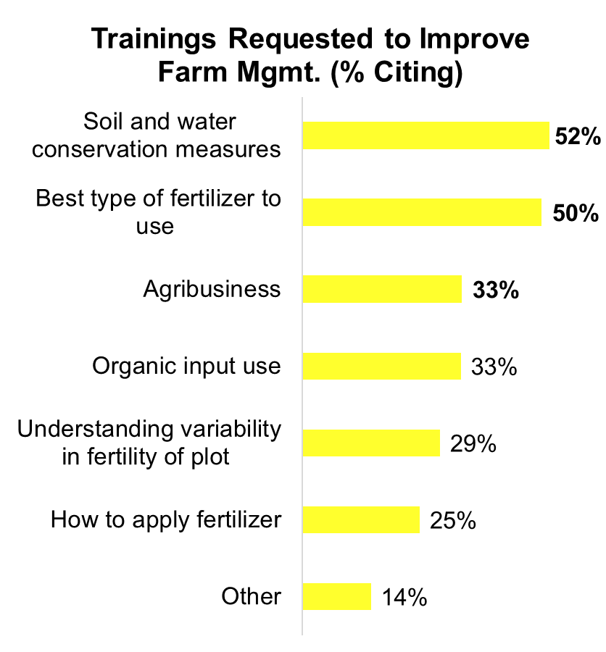
Summary Statistics of Some Variables

Slide 8
Summary Statistics of Some Variables

Slide 9
Summary Statistics of Some Variables

Slide 10
Data Use
Facilitate the evaluation of project impacts and effectiveness by establishing benchmarks and tracking changes in key metrics over time.
Provide insights for policy-making, funding decisions, and program adjustments by assessing interventions' direct and indirect effects.
Enable strategic decision-making for both suppliers and farmers through detailed analyses of fertilizer market trends and pricing structures.
Enhance the adoption of improved farming techniques and technologies by demonstrating their practical benefits and effectiveness in real-world settings.

Slide 11
How to Access Data
Data is available through AFAP’s Malawi office.
Contact Margaret Mukwenha, Country Director at
mmukwenha@afap-partnership.org
for inquiries.

Slide 12
Thank you!
PLEASE CONTACT US
AFAP Malawi: Margaret Mukwenha
Title: Country Director
Email: mmukwenha@afap-partnership.org

