Slide 1
CLIMATE CHANGE:
CAUSES, IMPACTS & OPPORTUNITIES FOR CLIMATE MARKETS TO ACCELERATE DEVELOPMENT IN MALAWI
Presented at the 13th ndizotheka eminent speaker searies
October 17, 2024

Slide 2
OUTLINE
Carbon Cycle
Climate Change – definition, drivers, impacts
Solutions
From Nature-based Solutions (NbS) to Carbon Credits
Carbon Project Cycle
Key Methodologies/Standards
Key Considerations
How Carbon Sequestration / Offsets Work
Carbon Benefit Sharing – example from the Kulera REDD+ Project
Points for Reflection

Slide 3
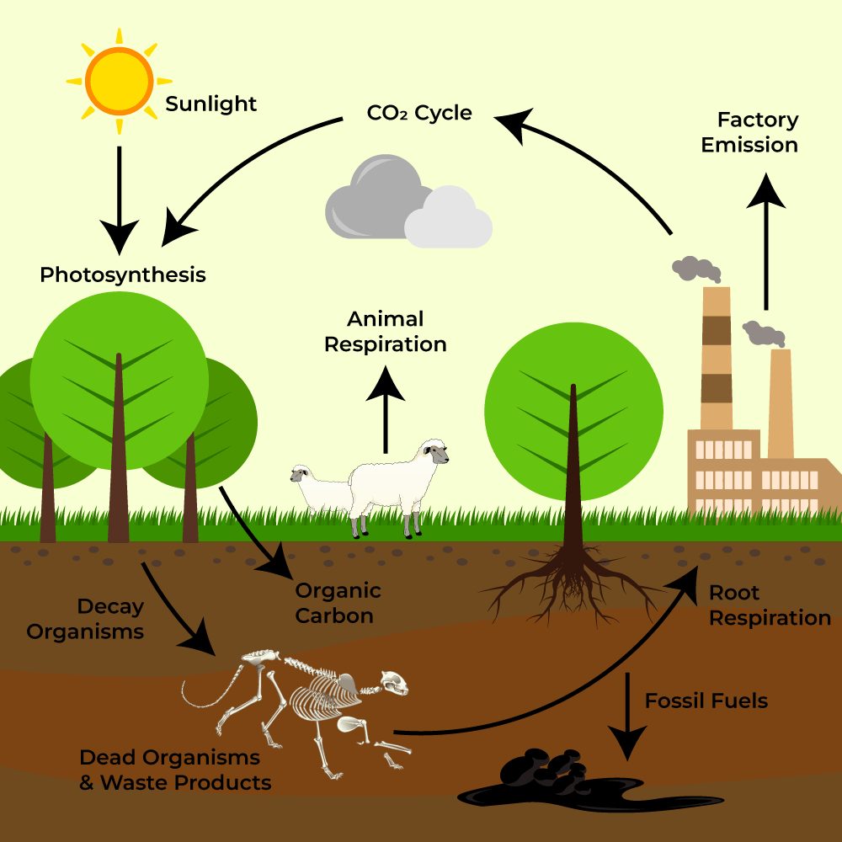
Schematic View of the Carbon Cycle

Slide 4
Climate Change Challenge
What is Climate Change?
A change in global or regional climate patterns, (apparent from the mid to late 20th century onwards) and attributed largely to the increased levels of atmospheric carbon dioxide.
Remember to distinguish between climate and weather!
How big is the problem?
Recent studies have found that monthly mean temperature records, extreme precipitation events, and average air moisture content have all risen over the last 50 to 150 years.
What is the biggest concern with Climate Change?
Most scientists believe that the cause of such unpredictable extremes is the “anthropogenic” (originating in human activities) buildup of greenhouse gases (GHG) in the atmosphere.

Slide 5
DRIVERS FOR CLIMATE CHANGE
  Deforestation due to agricultural expansion, over exploitation of forest resources, encroachment into protected areas, charcoal, forest fires, forest conversion for industrialization and other uses.
  Tillage practices (conventional) leading to loss of carbon from the soil ending up as carbon dioxide.
  Use of fossil fuel.
  Use of synthetic chemical fertilizers, especially nitrogen and phosphorus, will seriously reduce or in many cases even eliminate any soil carbon buildup.
  Toxins like pesticides are lethal to soil organisms, which play a crucial role in enhancing plant vitality and photosynthesis.
  Plastics.

Slide 6
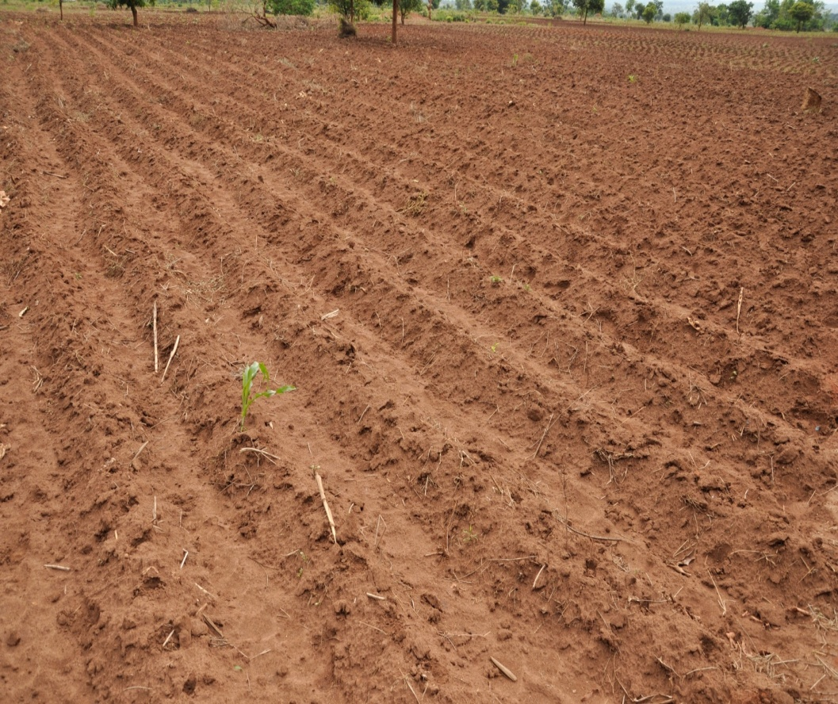
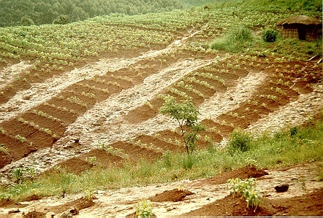
Conventional Ridge Tillage
Dry loose soil on ridges is subject to being washed down into the compacted furrows and off the field, thereby leading to carbon loss from the soil / loss of fertility.

Slide 7
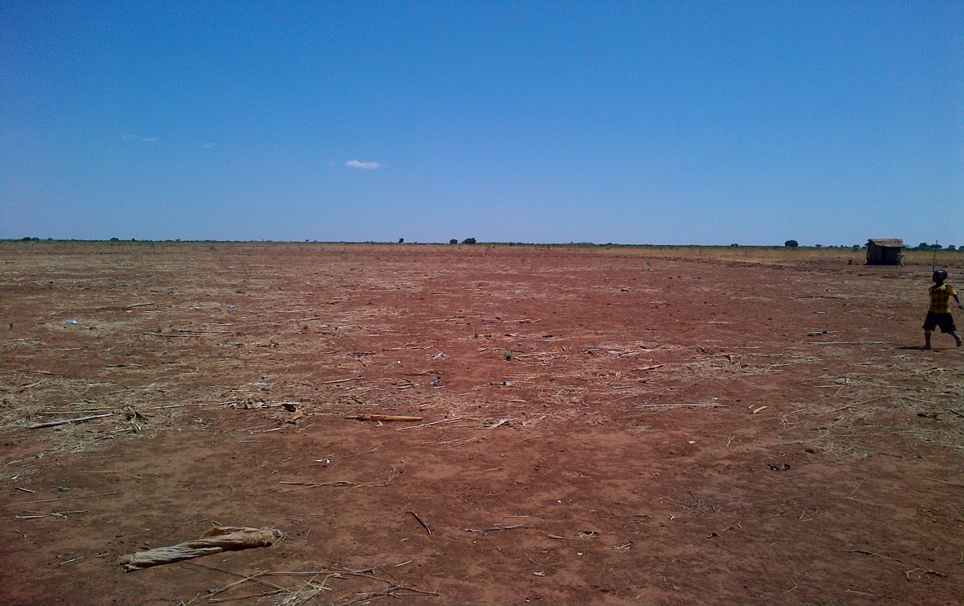
Deforested Environment in Farmland

Slide 8
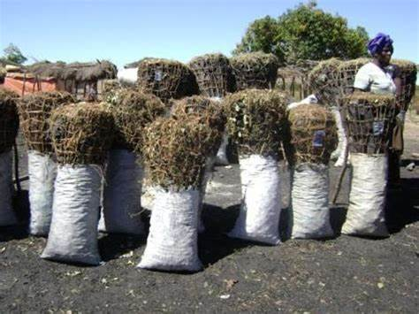
The majority of urban population uses charcoal for cooking, exerting pressure on the forests
8-10 tons wood is needed to make 1 ton of charcoal in local kilns

Slide 9
IMPACTS OF CLIMATE CHANGE
  Droughts
  Change in rainfall pattern
  Floods
  Outbreak of pests/diseases
  These environmental challenges disrupt social cohesion and economic stability, leading to increased poverty, inequality, and potential conflict.

Slide 10
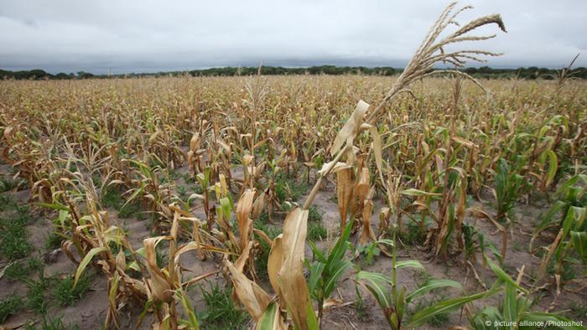
Crop Failure due to impact of El Nino

Slide 11
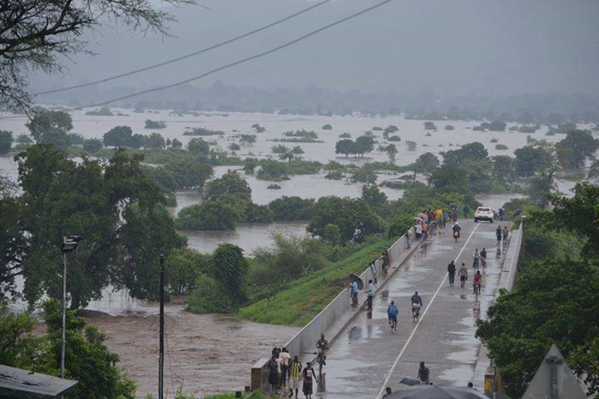
Flooding due to Freddy – causing loss of life, and damage to crops, property and infrastructure

Slide 12
Solutions to address the Climate challenge
Focus is on “Nature-based Solutions” with significant GHG mitigation potential through:
  Plantation forest/woodlots/afforestation
  Agroforestry
  Natural Regeneration (Farmer-managed & Assisted)
NOTE: Beside the NbS practices, communities are encouraged to follow complementary practices such as Good Agricultural Practices/Climate smart practices such as conservation agriculture, sustainable intensification, cover crops, etc.

Slide 13
From Nature-based Solutions or Other Mitigation Activities to Carbon Credits
Nature-based Solutions or other Mitigation Activities should have the potential to increase carbon sequestration (reduce emissions), reduce environmental degradation, conserve biodiversity and improve people's livelihoods
Once planned and implemented properly following all the procedures, standards, protocols, communities can deliver carbon projects with carbon credits of high integrity, high quality

Slide 14
Carbon Project Cycle
VALIDATION
Project design is audited by accredited third-party auditor
REGISTRATION
PERIODIC MONITORING
Record/document actual carbon impacts of project
VERIFICATION
Accredited third-party auditor verifies actual carbon impacts
CARBON CREDIT ISSUANCE
Project is issued verified carbon credits
Validated project is registered with a Carbon Registry
PROJECT DESIGN
1. Baseline (pre feasibility and feasibility)
2. Funding & Approval
3. Project Design Document

Slide 15
Key Methodologies/Standards
A set of rules & guidelines needs to be followed in order to undertake a project and generate and quantify its climate mitigation (carbon credits)
It influences project design, e.g., who can participate in the project, on what type of land the project can be implemented
It determines carbon sequestration and GHG emissions sources to include
Types of carbon markets – Compliance (under Article 6.2) and Voluntary (of great interest to the majority of investors and proponents)
Types of carbon offset projects: Generally, two types of carbon offsets – those that reduce emissions from existing or future operations (carbon avoidance – maninly renewable energy), and those that remove existing carbon in the atmosphere (carbon removal – such as nature-based solutions).
Carbon Standards used for the voluntary markets are Gold Standards, VERRA & CDM
In order for the carbon projects to achieve high quality, high integrity credits they must adhere to the core carbon principles set by the Integrity Councils for the Voluntary Carbon Markets (ICVCM)

Slide 16
Key Considerations
Secure interest, commitment from the prospective project participants
First – clarify project participants and their obligations/contributions/rights in the project through Free Prior Informed Consent (FPIC) processes
Think permanence: What actions will sustain project activities and carbon for a long-term (>20 years)?
Look at national laws: Consider national legal context and how it may affect the project design/implementation (Malawi Govt has produced the Carbon Regulatory Framework awaiting Cabinet approval)
Leakage: GHG emissions outside the project boundary as a result of the project (eg displacement of agricultural activities might result in deforestation or intensification of use of non-wooded land elsewhere).
Additionality: A carbon project is additional if the emission reduction or removals would not have occurred without revenue from the sale of carbon credits (see photos in the next slides)

Slide 17
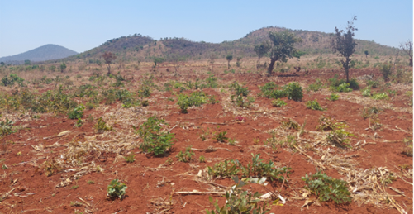
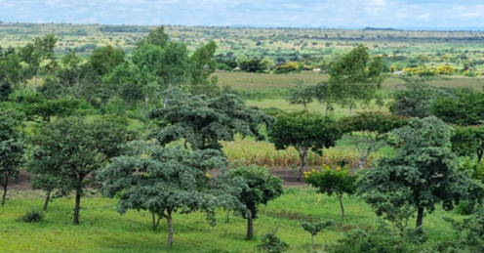
Farmer- managed Natural Regeneration
FMNR

Slide 18
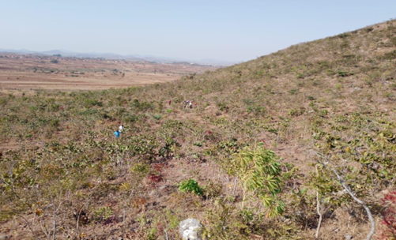
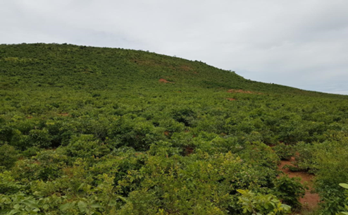
ANR

Slide 19
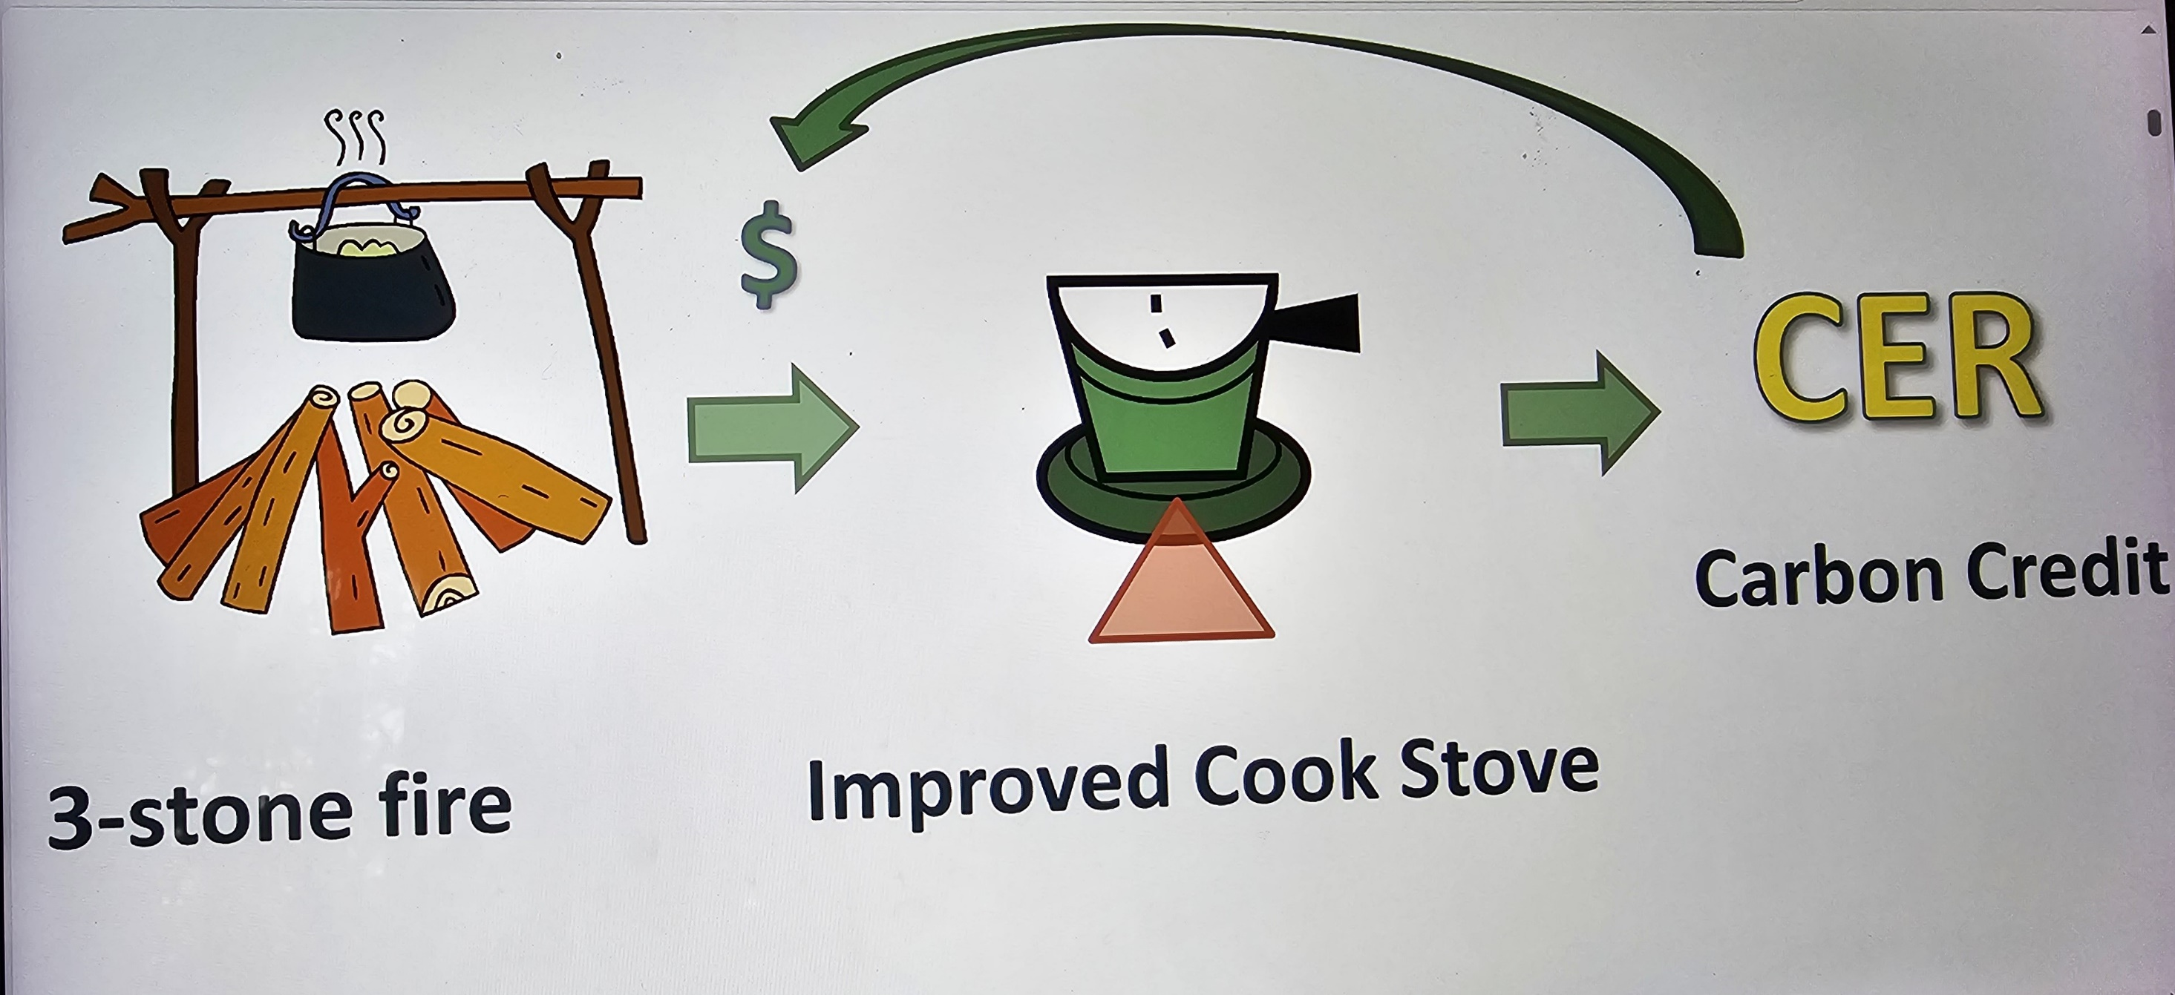

Slide 20
Key Considerations
  Legally enforceable carbon agreements (between Government, investor, proponent, farmers)
  Ensure strong and functional community governance structures
  Government commitment
Land governance (tenure rights, registration, conflict management):
  Land rights (who owns the land? Is it secure)
  Carbon rights (Transfer of rights from landowners to investor/project proponent)
Carbon calculation: (Good data, Good equations/formulas to compute tree biomass/carbon values from the good data)
Monitoring, reporting and verification
Carbon credit integrity and quality a MUST!
TRANSPARENCY!!!!

Slide 21
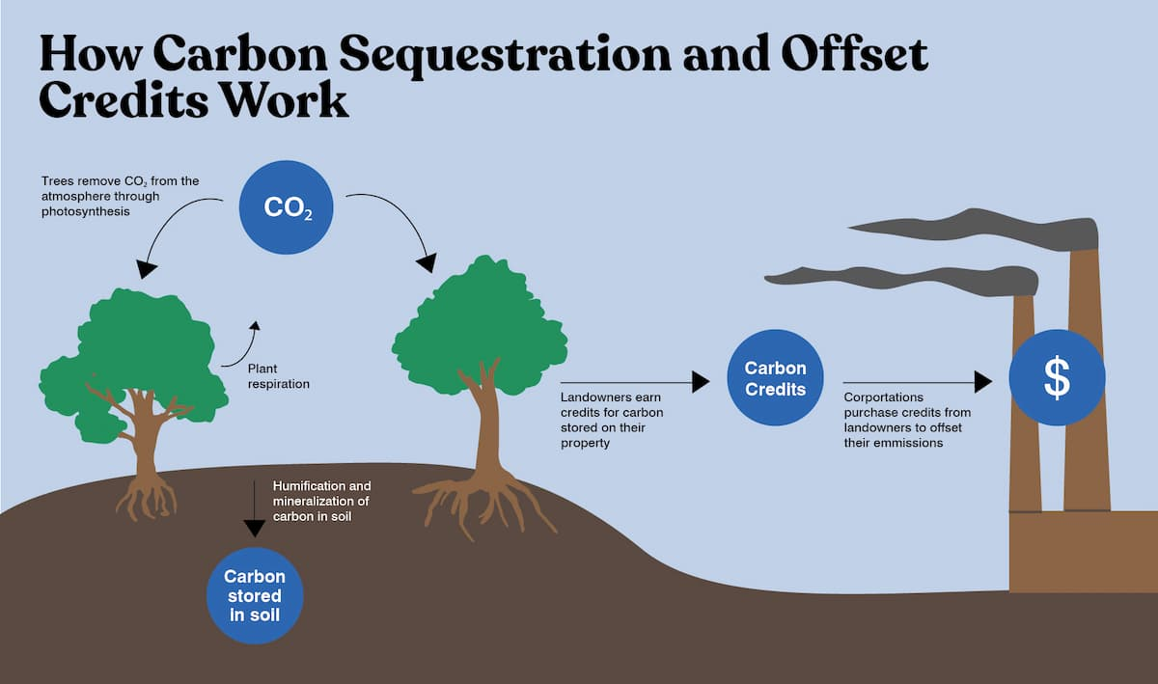
Part of the carbon credits re-invested in NbS and community development

Slide 22
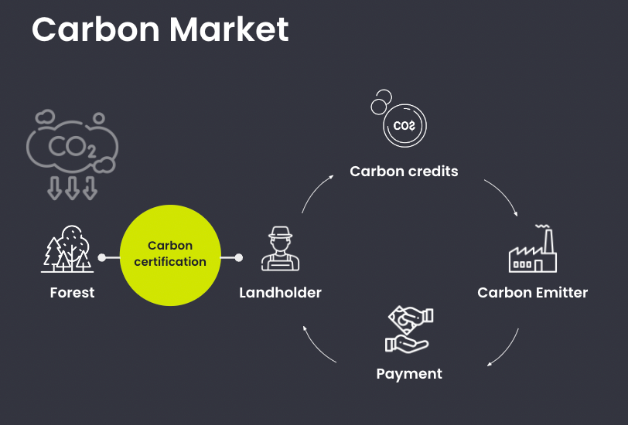
More Elaboration on carbon credits/markets

Slide 23
Carbon Benefit Sharing
One of the most contentious elements of any carbon project is how carbon revenues are shared among the communities, investor, proponents/carbon developer and government
An example, though may not be the best, is the Kulera Landscape REDD+ project which developed a framework that can be perfected.
Slides that follow show how the carbon benefit sharing framework was developed under the project.

Slide 24
Under the Kulera REDD+, a Triparty Agreement involving the DNPW, TGC (seller’s entity) and the Associations for managing and sharing carbon credits was developed ensuring the following:
  Roles & responsibilities of each party
  Ensuring that carbon agreements are legally enforceable
  Obtain rights holders’ prior informed consent and document responsibilities and benefits in carbon project
  Transfer carbon rights to benefit-sharing entity
  Committing Govt to the carbon project
Developing a Governance Structure for Benefit Sharing

Slide 25
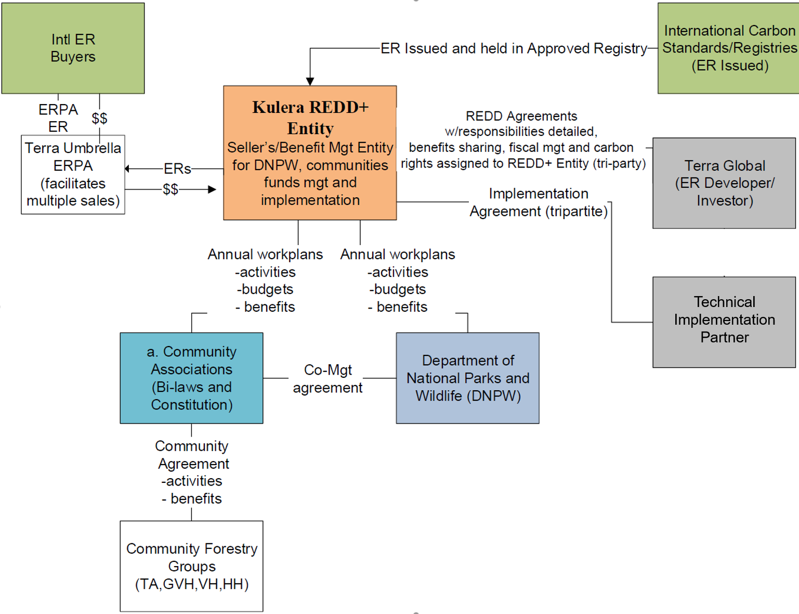
Governance Structure of the Triparty Agreement
Associations, GoM and TGC
90% of all carbon credits go to the Kulera REDD+ Program
Notes:
Technical implementation partner

Slide 26
How Benefits are Distributed
The Project is expected to generate approximately 6.3 million VCUs over its 30-year crediting period before risk buffer deductions (normally = 25%)
The parties (DNP, NVA, NAWIRA and Terra Global Capital) agreed to adopt a benefit distribution policy under which the net income from Carbon Credits is distributed to local communities for resource management, livelihood improvements and direct employment benefits
See example below how revenues were distributed

Slide 27
How Communities Benefit from Carbon Credits/ Revenues
Social-economic benefits from capacity building
Direct from project actions:
  Employment opportunities
  Improved livelihoods via project actions (sustainable fuelwood, agriculture intensification, energy solutions, etc.)
  Development of income streams (NFTP, tree crops (e.g., coffee & macadamia), sustainable local timber)
  Direct financial payments from carbon credit sales

Slide 28
How Communities Benefit from Carbon Credits/Revenues
Indirect:
  Non-project programs financed by project income (rehabilitation of schools, wells, health facilities, etc.)
Tangential:
  Improved forest cover and products, water and soil quality, and increased biodiversity

Slide 29
How Revenues were shared under Kulera for the second crediting period (courtesy – TGC)

Slide 30
AREAS FOR FURTHER ENGAGEMENT
What is the actual size of the Malawi carbon market landscape – tonnage and value?
Where do we have the comparative advantage – where are/which are the low hanging fruits? – Agriculture, Forestry/Other PAs, Energy, Water & Sanitation, etc?
Do we have the technical capacity to engage in carbon markets? Where are our strengths / gaps?
How attractive is our carbon market regulatory framework – is it competitive?
How can the Malawi Carbon Market Initiative drive the investment drive?

Slide 31
Questions and Answers
  ZIKOMO!

