Slide 1
Testing a Tool for Co-Creating Sustainable Agri-Food Systems (CoSAF) in Resource -poor Contexts in Malawi.
Frank Tchuwa, Daimon Kambewa, Elaine Ferguson, Frances Knight, Webster Jassi Daniso Mkweu, Carolyne Phiri
Lilongwe University of Agriculture and Natural Resources,
London School of Tropical Medicine and Hygiene, United Kingdom

Slide 2
How can we help farmers navigate complex realities?
Poor soils
Pests and diseases
Poor markets
Climate variability
Weak institutions
Social injustice
Farmers Operate in complex contexts
Diverse socio-economic, political, cultural and biophysical contexts
Face “wicked problems” which are
Unstructured-no clear cause and effect
Crosscutting
Relentless- cannot be solved “once and for all”
(Weber and Khademian, 2008)
Notes:
Soil problems are wicked as they are caused by many issues including institutions, markets, pests and diseases and climate e.g., cyclones in Malawi

Slide 3
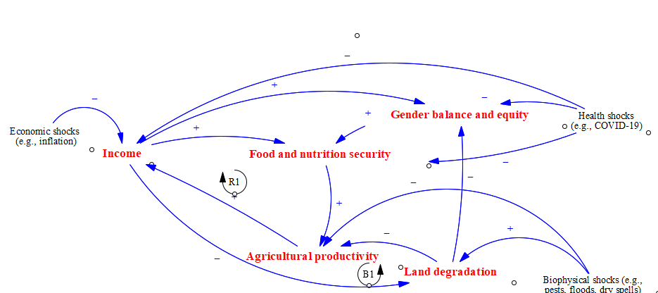
How can farmers reconcile conflicting goals? What decisions do they need to take?

Slide 4
CoSAF as a decision-making tool
an integrated participatory decision-making tool,
to inform food production decisions that improve nutritional adequacy and sustainability of local agri-food systems
Draws from
Social learning principles
Participatory digital extension
Systems thinking
What should farmers produce to attain food, nutrition, economic, environmental and social benefits?

Slide 5
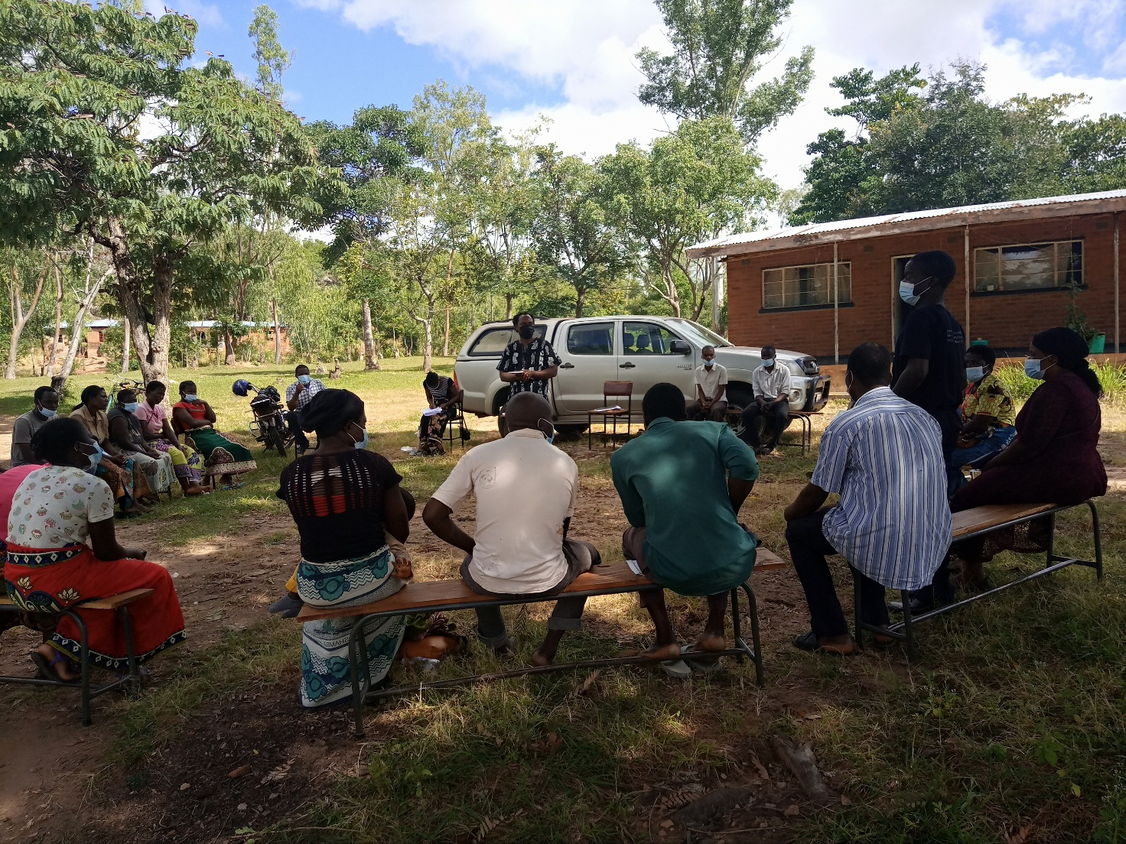
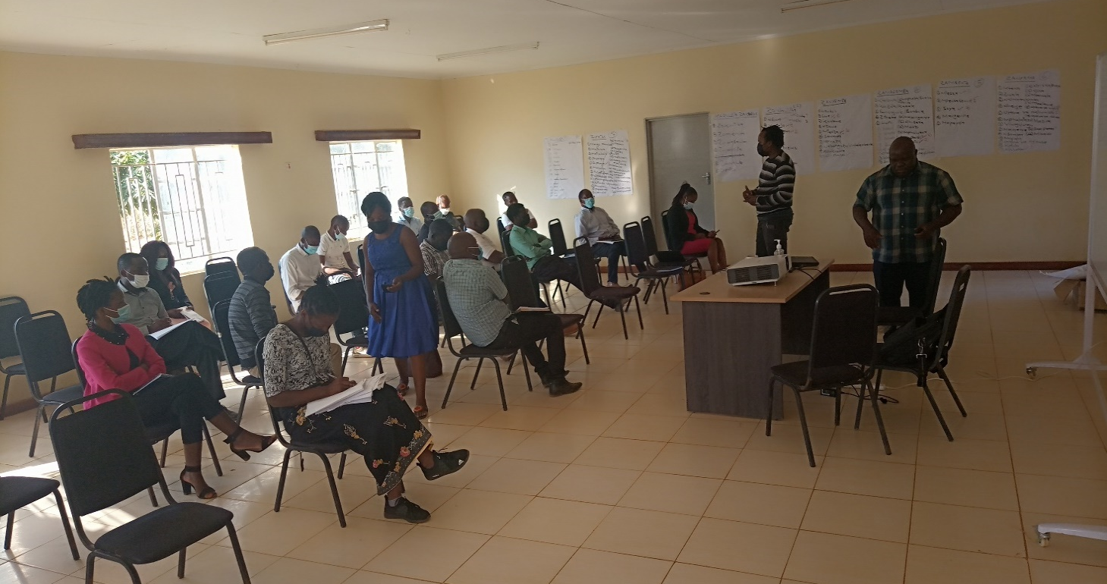
Methods: Listening from grassroots multistakeholder platforms
Study approach
Dialogue workshops
Sites
Kaluluma (Kasungu)
Kandeu (Ntcheu)
Groups involved (120 sample)
Farmer Research Networks
Care groups
Village Natural Resources Committees

Slide 6
COSAF steps
Participatory Soil testing
Reflectometer and PROBE
Discussions on nutrition adequacy
Agri-food tool
Discuss weather outlook
Trade-off analysis on options selected
Collect data on production options discussed (group), chosen and practiced by individual farmers (soil improving options, crops, animals, trees) al

Slide 7
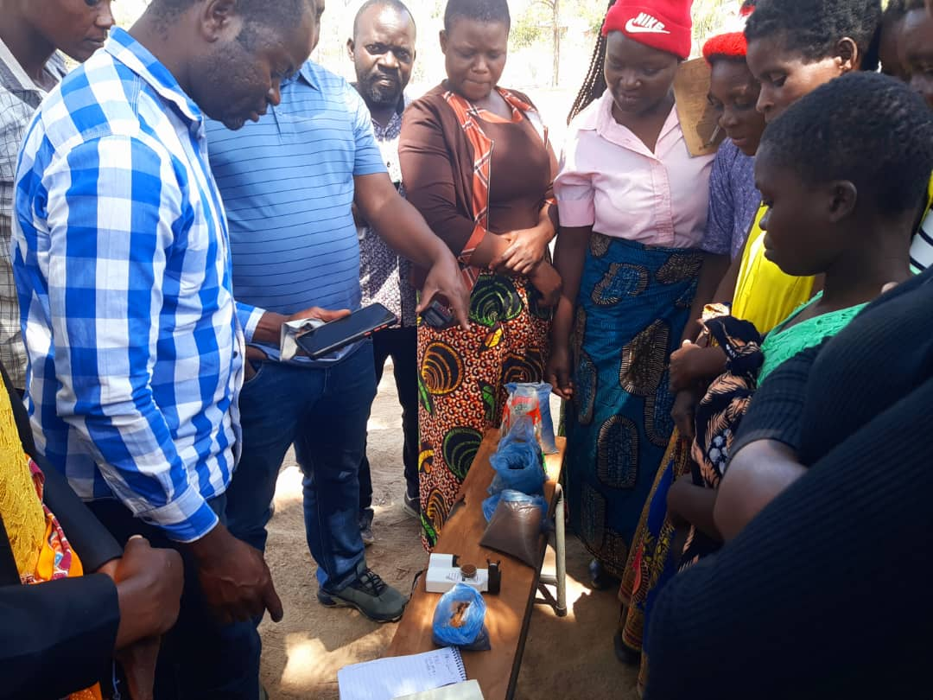
Testing soils with farmers

Slide 8
Results from soil testing (Kaluluma)
Reflectometer | Probe
 | Fertility | pH
2.6 | Low | Medium
3.4 | Low | Medium
4.1 | Low | Medium
3.701 | Low | Medium
4.1 | Low | Medium
2.0 | Low | Medium
2.15 | Low | Medium
1.638 | Low | Medium
1.4 | Low | Medium
3.807 | Low | Medium
2.478 | Low | Medium
1.890 | Low | Medium
1.561 | Low | Medium

Slide 9
Solutions discussed with farmers
Kaluluma
manure application, residue incorporation, planting tephrosia vogelii, practising crop rotation, Mulching, agroforestry, pit planting, constructing marker ridges, planting vetiver, fallowing, intercropping, CA, and application of the anthill soils in the furrows.
Kandeu
planting vetiver, constructing marker ridges, planting tephrosia vogelii, residue incorporation, application of compost manure, intercropping, application of livestock manure, agroforestry, CA, pit planting, application of anthill soils in the furrows, practising crop rotation.

Slide 10
Way forward
Data collection is on-going upto 2025

Slide 11
Thank you

